Slide 1
SVM

Slide 2
Support Vector Machine
SVM is a machine learning algorithm used for classification.
In SVM, we first plot the data points on a graph.
Then, we draw a line, called the decision boundary, which separates the data points into two classes.

Slide 3
Example
'x1': [2, 3, 2, 1.5, 3.5, 4, 3, 2.5, 5, 6, 5.5, 4.5, 6, 5, 6.5],
'x2': [4, 5, 6, 5.5, 6.5, 4, 4.5, 5.5, 1, 2, 2.5, 2, 3, 3.5, 2.5],
'class': [+1, +1, +1, +1, +1, +1, +1, +1, -1, -1, -1, -1, -1, -1, -1]

Slide 4
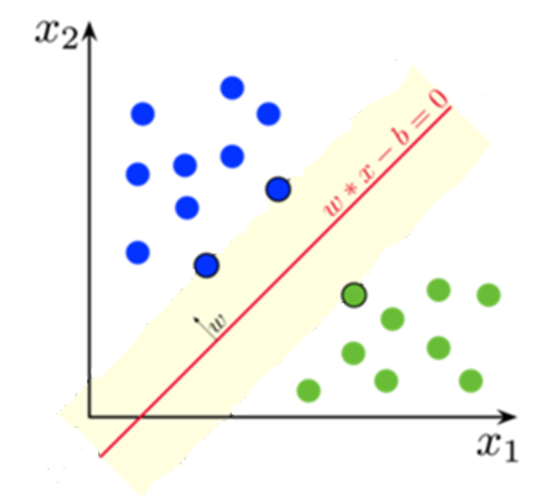

Slide 5
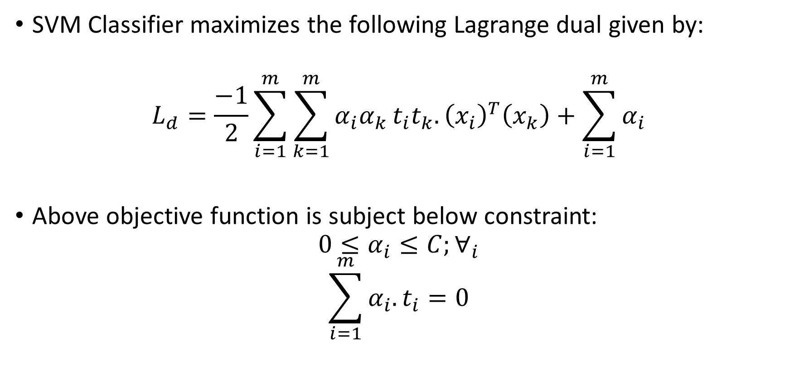
The SVM Optimization Problem
SVM Classifier maximizes the following Lagrange dual given by:
$$L_{d}=\frac{−1}{2}\sum_{i=1}^{m}{\sum_{k=1}^{m}{α_{i}α_{k}}}t_{i}t_{k}.{\left(x_{i}\right)}^{T}\left(x_{k}\right)+\sum_{i=1}^{m}{α_{i}}$$
Above objective function is subject below constraint:
$$0≤α_{i}≤C;∀_{i}$$
$$\sum_{i=1}^{m}{α_{i}.t_{i}=0}$$

Slide 6
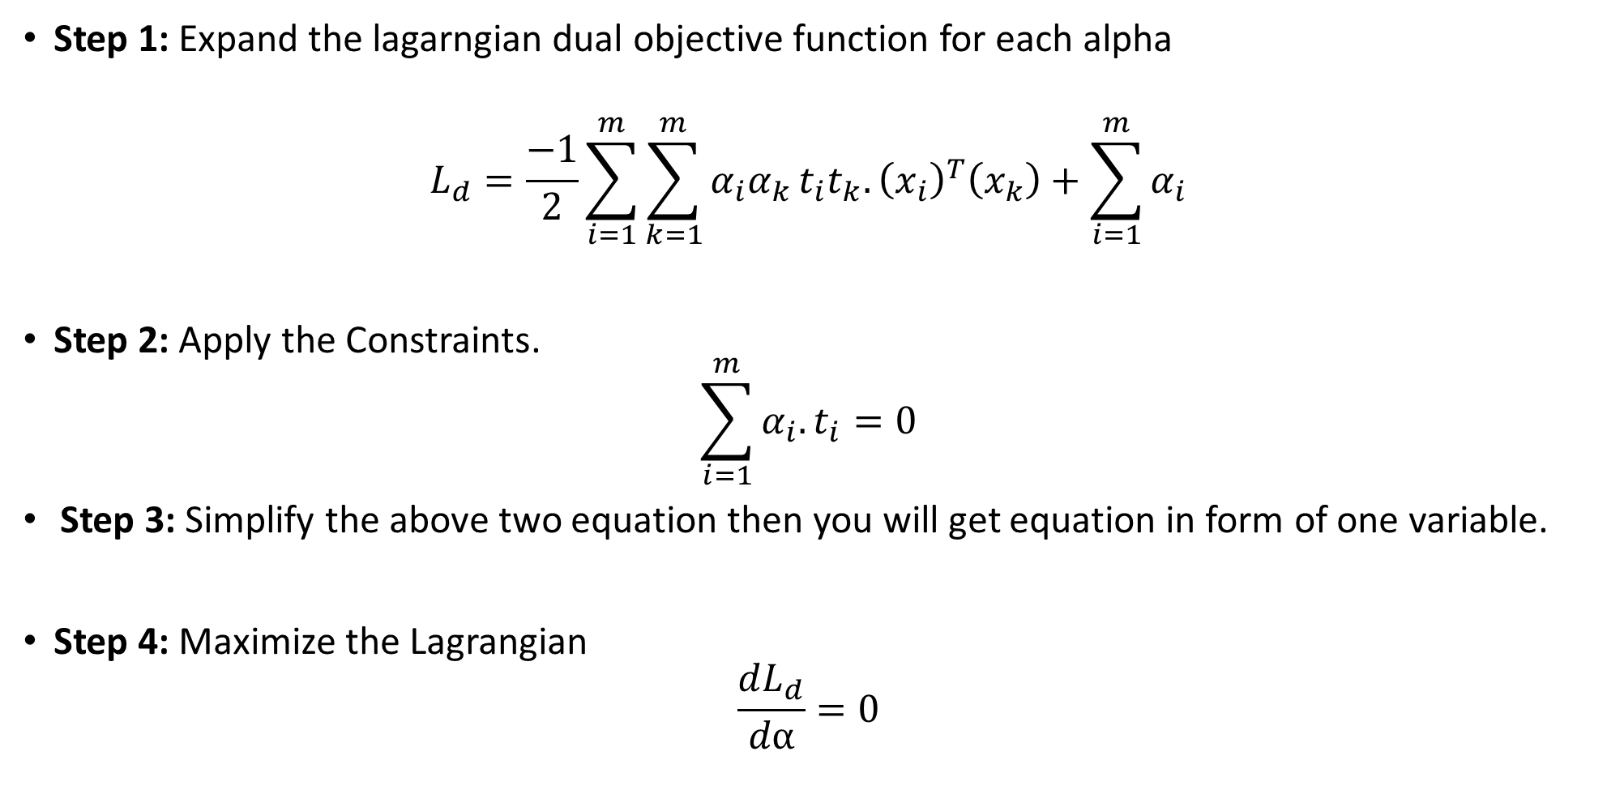
Support Vector Machine: A Step-by-Step Process
Step 1: Expand the lagarngian dual objective function for each alpha
$$L_{d}=\frac{−1}{2}\sum_{i=1}^{m}{\sum_{k=1}^{m}{α_{i}α_{k}}}t_{i}t_{k}.{\left(x_{i}\right)}^{T}\left(x_{k}\right)+\sum_{i=1}^{m}{α_{i}}$$
Step 2: Apply the Constraints.
$$\sum_{i=1}^{m}{α_{i}.t_{i}=0}$$
Step 3: Simplify the above two equation then you will get equation in form of one variable.
Step 4: Maximize the Lagrangian
$$\frac{dL_{d}}{dα}=0$$

Slide 7
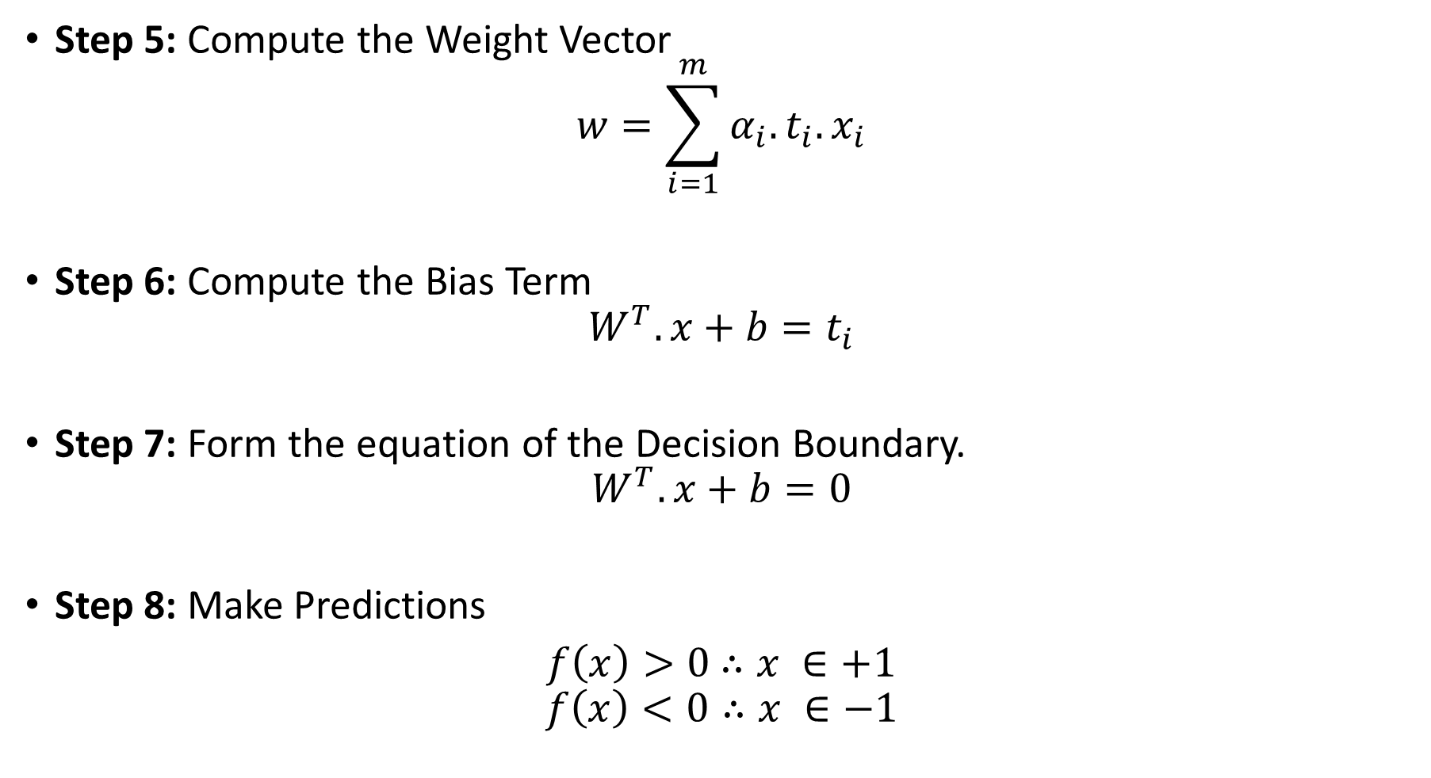
Step 5: Compute the Weight Vector
$$w=\sum_{i=1}^{m}{α_{i}.}t_{i}.x_{i}$$
Step 6: Compute the Bias Term
$$W^{T}.x+b=t_{i}$$
Step 7: Form the equation of the Decision Boundary.
$$W^{T}.x+b=0$$
Step 8: Make Predictions
$f\left(x\right)>0$ $∴x ∈+1$
$$f\left(x\right)<0∴x ∈−1$$

Slide 8
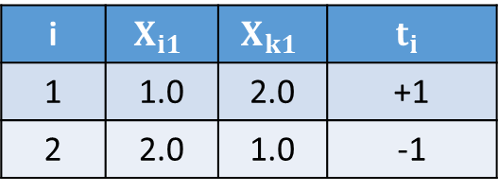
Example:
For the given training example, find the Lagrange multiplier, weights, and bias for the decision boundary, and predict for x=(2.5,1.5).
i | $$X_{i1}$$ | $$X_{k1}$$ | $$t_{i}$$
1 | 1.0 | 2.0 | +1
2 | 2.0 | 1.0 | -1

Slide 9
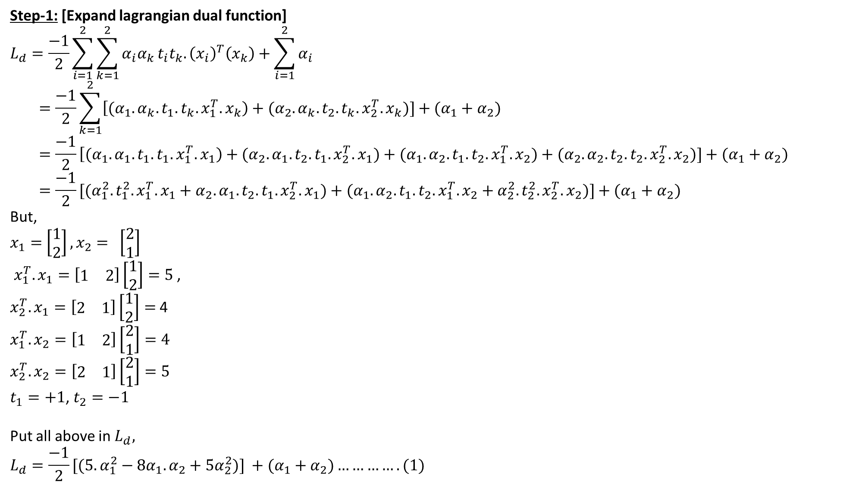
Step-1: [Expand lagrangian dual function]
$$L_{d}=\frac{−1}{2}\sum_{i=1}^{2}{\sum_{k=1}^{2}{α_{i}α_{k}}}t_{i}t_{k}.{\left(x_{i}\right)}^{T}\left(x_{k}\right)+\sum_{i=1}^{2}{α_{i}}$$
$$=\frac{−1}{2}\sum_{k=1}^{2}{\left[{(α}_{1}.α_{k}.t_{1}.t_{k}.x_{1}^{T}.x_{k}\right)+{(α}_{2}.α_{k}.t_{2}.t_{k}.x_{2}^{T}.x_{k})]}+(α_{1}+α_{2})$$
$$=\frac{−1}{2}\left[{(α}_{1}.α_{1}.t_{1}.t_{1}.x_{1}^{T}.x_{1}\right)+{(α}_{2}.α_{1}.t_{2}.t_{1}.x_{2}^{T}.x_{1})+{(α}_{1}.α_{2}.t_{1}.t_{2}.x_{1}^{T}.x_{2})+{(α}_{2}.α_{2}.t_{2}.t_{2}.x_{2}^{T}.x_{2})]+(α_{1}+α_{2})$$
$$={\frac{−1}{2}[(α}_{1}^{2}.t_{1}^{2}. x_{1}^{T}.x_{1}+α_{2}.α_{1}.t_{2}.t_{1}.x_{2}^{T}.x_{1})+{(α}_{1}.α_{2}.t_{1}.t_{2}.x_{1}^{T}.x_{2}+α_{2}^{2}.t_{2}^{2}. x_{2}^{T}.x_{2})]+(α_{1}+α_{2})$$
But,
$x_{1}=$ $\left[\begin{aligned}1 \\ 2\end{aligned}\right],x_{2}= \left[\begin{aligned}2 \\ 1\end{aligned}\right]$
$x_{1}^{T}.x_{1}=\left[\begin{matrix}1 & 2\end{matrix}\right]\left[\begin{aligned}1 \\ 2\end{aligned}\right]=5$ ,
$x_{2}^{T}.x_{1}=\left[\begin{matrix}2 & 1\end{matrix}\right]\left[\begin{aligned}1 \\ 2\end{aligned}\right]=$4
$$x_{1}^{T}.x_{2}=\left[\begin{matrix}1 & 2\end{matrix}\right]\left[\begin{aligned}2 \\ 1\end{aligned}\right]=4$$
$$x_{2}^{T}.x_{2}=\left[\begin{matrix}2 & 1\end{matrix}\right]\left[\begin{aligned}2 \\ 1\end{aligned}\right]=5$$
$t_{1}=+1$, $t_{2}=−1$
Put all above in $L_{d},$
$$L_{d}={\frac{−1}{2}[(5.α}_{1}^{2}−8α_{1}.α_{2}+5α_{2}^{2})] +(α_{1}+α_{2})………….(1)$$

Slide 10
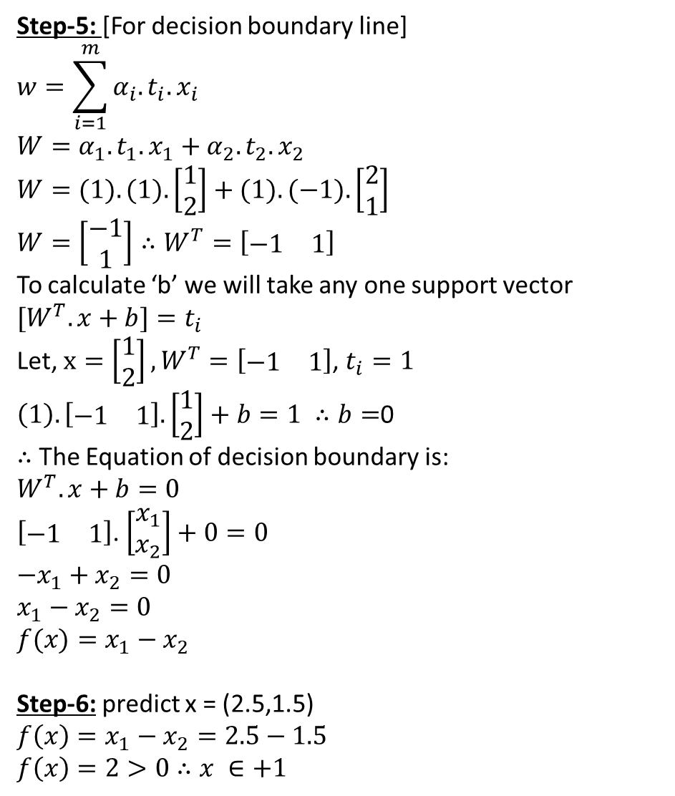
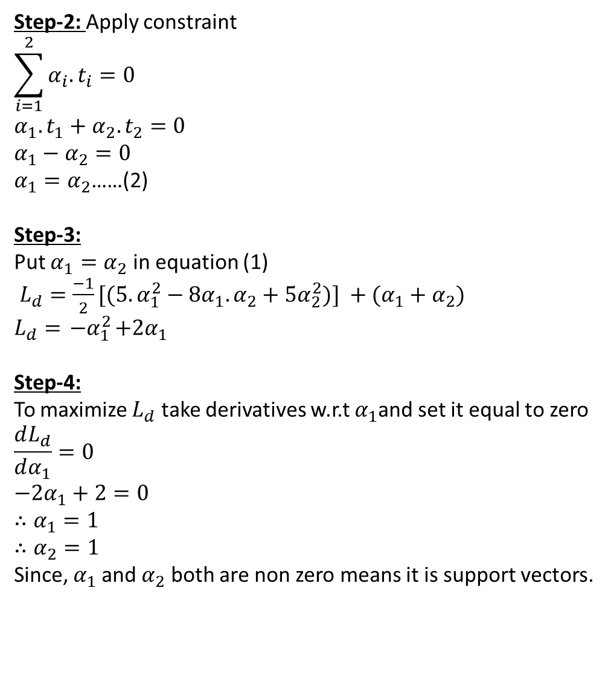
Step-2: Apply constraint
$$\sum_{i=1}^{2}{α_{i}.t_{i}=0}$$
$$α_{1}.t_{1}+α_{2}.t_{2}=0$$
$$α_{1}−α_{2}=0$$
$α_{1}=α_{2}$……(2)
Step-3:
Put $α_{1}=α_{2}$ in equation (1)
$L_{d}={\frac{−1}{2}[(5.α}_{1}^{2}−8α_{1}.α_{2}+5α_{2}^{2})] +(α_{1}+α_{2})$
$$L_{d}={ −α}_{1}^{2}+2α_{1}$$
Step-4:
To maximize $L_{d}$ take derivatives w.r.t $α_{1}$and set it equal to zero
$$\frac{dL_{d}}{dα_{1}}=0$$
$$−2α_{1}+2=0$$
$$∴α_{1}=1$$
$$∴α_{2}=1$$
Since, $α_{1}$and $α_{2}$ both are non zero means it is support vectors.
Step-5: [For decision boundary line]
$$w=\sum_{i=1}^{m}{α_{i}.}t_{i}.x_{i}$$
$$W=α_{1}.t_{1}.x_{1}+α_{2}.t_{2}.x_{2}$$
$$W=(1).(1).\left[\begin{aligned}1 \\ 2\end{aligned}\right]+(1).(−1).\left[\begin{aligned}2 \\ 1\end{aligned}\right]$$
$$W=\left[\begin{aligned}−1 \\ 1\end{aligned}\right]∴W^{T}=\left[\begin{matrix}−1 & 1\end{matrix}\right]$$
To calculate ‘b’ we will take any one support vector
$$[W^{T}.x+b]=t_{i}$$
Let, $x=\left[\begin{aligned}1 \\ 2\end{aligned}\right],W^{T}=\left[\begin{matrix}−1 & 1\end{matrix}\right]$, $t_{i}=1$
$\left(1\right).\left[\begin{matrix}−1 & 1\end{matrix}\right].\left[\begin{aligned}1 \\ 2\end{aligned}\right]+b=1 ∴b=$0
$∴$ The Equation of decision boundary is:
$$W^{T}.x+b=0$$
$\left[\begin{matrix}−1 & 1\end{matrix}\right]$. $\left[\begin{aligned}x_{1} \\ x_{2}\end{aligned}\right]+0=0$
$${−x}_{1}+x_{2}=0$$
$$x_{1}−x_{2}=0$$
$$f(x)=x_{1}−x_{2}$$
Step-6: predict x = (2.5,1.5)
$$f\left(x\right)=x_{1}−x_{2}=2.5−1.5$$
$f\left(x\right)=2>0$ $∴x ∈+1$

Slide 11
